Slide 1




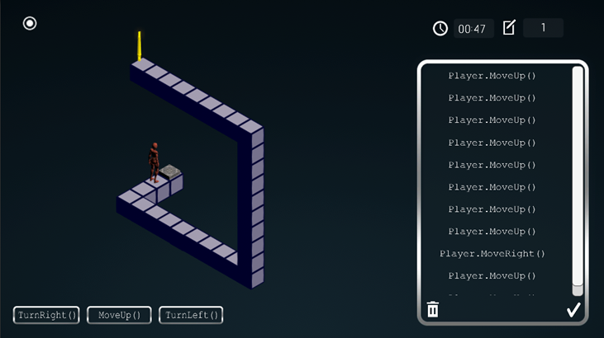
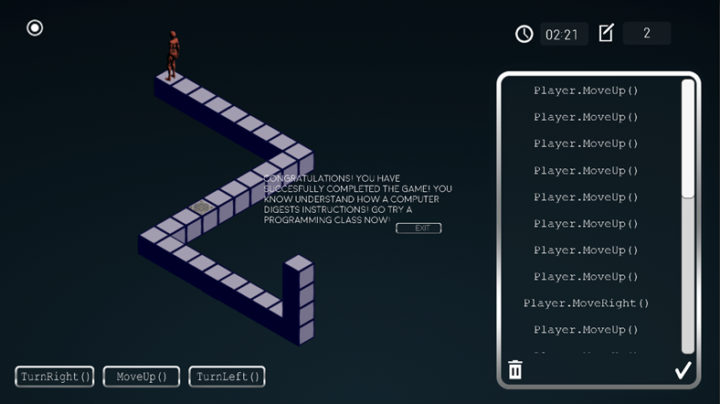




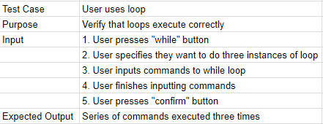
VIP Senior Project Spring 2018
AR-VR-VE For Computer Science : A Desktop Game
Student:
Carlos M. Martinez, Florida International University
Mentor: Dr. Francisco Ortega, School of Computing and Information Sciences
Professor: Masoud Sadjadi, Florida International University
Problem
For the last 30 years Computer Science has had a diversity problem. The number of women who major in Computer Science has been in a steady decline. This is due to the fact that Computer Science is not seen as an accessible major.
Solution
The solution is to design a game with the goal of making Computer Science seem more accessible. By giving the user an idea on how programming works and give them the basics of programming in a fun and interesting way. A very important part of this project was both the ability to control and issue commands to the character
Current System
Previous version of a game made involved attempting to free a little robot from a jail cell.
Only taught the very basics of programming
Done in VR so not as widely accessible
Screenshots
Picture of Level 1 with commands inputted into command holder
Picture of the player completing level 1
Requirements
The system allows to the user to move their character in a variety of ways:
Turn Left
Turn Right
Continuously re-execute a series of commands in a loop
System Design and Implementation
Unity: Was used as game engine
C#: Programming language used for scripts
GameSparks: Used to store user information and score onto a server
Github: Used for Version Control
Future Work
Implementing a way to save a series of commands into a method
Implementing object oriented programming
Add more levels to the game
Verification
Summary
This game will represent the next step in bridging the gap between the number of male and female students majoring in Computer Science and will clear any previous misconceptions on the difficulty of getting into computer science
Acknowledgement
The material presented in this poster is based upon the work supported by Samira Tellez, Arelys Alvarez, Fidel Hernandez and Mairim Barrios. I am thankful to the help that I received from my group members. Follow us @FIUSCIS
Object Design / UML Diagrams
Notes:
‹#›

